Slide 1
Divide and Conquer?
COMPARING CENTRALIZED AND DISTRIBUTED ARCHITECTURES IN LARGE LANGUAGE MODELS
Notes:
Hello everyone, today we'll be presenting our project titled

Slide 2
Large Language Models (LLMs) are transformative for language technology due to their remarkable capabilities.
As LLMs grow larger and more complex, architectural decisions for deployment become critical.
INTRODUCTION
Traditional centralized architectures faces many challenges such as:
Face scalability challenges
Limit full potential of LLMs
Notes:
Large Language Models (LLMs) have emerged as a transformative force, reshaping the landscape of language technology with their remarkable capabilities . However, as these models continue to grow in size and complexity, the architectural decisions underpinning their deployment become increasingly critical as hosting and deploying these complex LLMs on low end hardware devices becomes an issue.
Traditional centralized architectures where the LLMs are hosted on a single device , face scalability challenges due their computational expensiveness and threaten to limit the full potential of LLMs.

Slide 3
Distributed architectures provides a promising alternative as:
Harness power of multiple computers
Can host and serve massive LLMs
Benefits of distributed architectures:
Scalability
Improved performance
Notes:
In contrast, distributed architectures offer a promising alternative, harnessing the collective power of multiple computers to host and serve these massive models.
The distributed architecture helps in overcoming the scalability challenges by providing required computational power and
The availability of required amount of memory enables the complete utilization of sophisticated model capabilities.
But while we discuss the benefits of distributed architectures, we must also discuss some of the drawbacks such as the network bandwidth overheads and synchronization issues among the nodes which host the model. As well as tackle some of the misconceptions that exist within the global community when we talk about distributing a neural network across multiple devices. So what we have done is we have used Microsoft's open-source framework called Petals to distribute Meta's cutting-edge LLM Llama 3 which has only been released a few days ago.

Slide 4

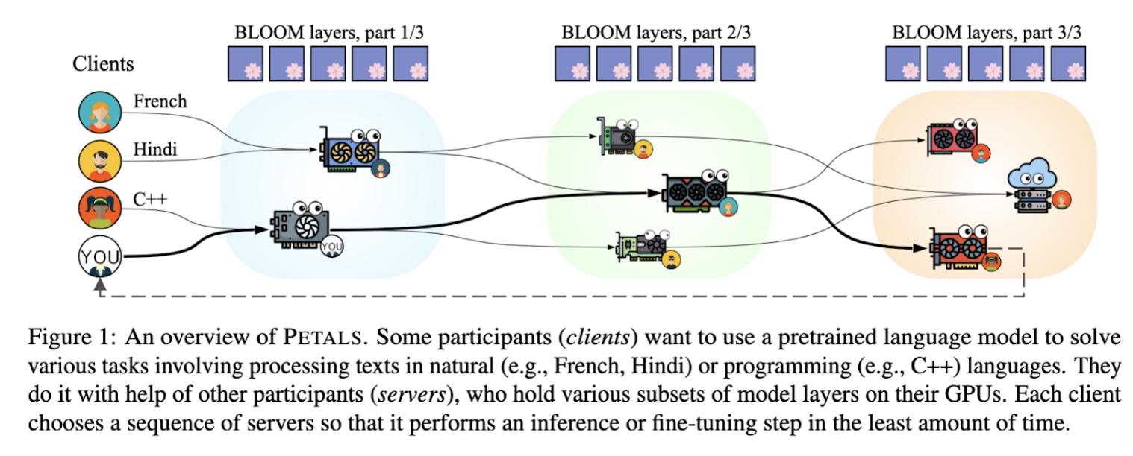
PETALS
A system for inference and fine-tuning of large models collaboratively by joining the resources of multiple parties
Notes:
To tackle the task of hosting massive LLMs on a distributed network, we leveraged the power of Petals - a framework designed specifically for distributed machine learning workloads.

Slide 5
HOW DOES IT WORK?
PETALS enables collaborative inference and fine-tuning of large language models by leveraging the combined resources of multiple devices/participants.
Participants can run a server, client, or both roles
Servers host subsets of the model layers (e.g., Transformer blocks) on their GPUs
Clients form chains of servers to run inference or fine-tuning steps across the entire model
Notes:
Participants can run server, client or both roles
Servers host subsets of the model layers on their GPUs
Clients form chains of servers to handle inference or fine-tuning

Slide 6
INFERENCE PROCESS:
Client stores token embeddings locally (small fraction of total parameters)
Client finds a chain of servers holding all model layers
Client sends token embeddings to the first server in the chain
Each server computes activations for its layers and passes to the next server
Final server returns representations to the client
Client computes next token probabilities based on final representations
Notes:
Let's walk through how the inference process works with PETALS:
The client stores the token embeddings locally - a small fraction of the total model parameters
The client finds an available chain of servers that collectively hold all the model layers
The client sends the token embeddings to the first server in the chain
Each server computes activations for its layers and passes them to the next server
The final server returns the representations back to the client
The client can then compute the next token probabilities based on these final representations

Slide 7
FINE-TUNING PROCESS:
STEP 1
STEP 2
STEP 3
STEP 4
Clients "own" trainable parameters (e.g., adapters, soft prompts)
Servers host original pretrained layers and compute activations
Client routes training data through a server chain to get representations
Client obtains predictions with a local classification head
Notes:
Beyond just inference, PETALS also enables collaborative fine-tuning of large language models in a distributed manner.
Clients "own" the trainable parameters like adapters or soft prompts
Servers host the original pretrained model layers
Servers compute and pass activations, but don't store trainable params
During the forward pass for fine-tuning:
The client routes batches of training data through an available server chain
Servers compute activations for their layers and pass to the next server
The client obtains representations from the final server
The client's local classification head generates predictions

Slide 8
BACKPROPAGATION
STEP 1
STEP 2
STEP 3
STEP 4
Client computes gradients for local parameters
Client sends activations backwards through the same server chain
Servers compute gradients w.r.t. activations, return to client
Client updates local parameters using gradients
Notes:
The backward pass then works as follows:
The client computes gradients for its local trainable parameters
It sends the activations backwards through the same server chain
Each server computes gradients w.r.t the activations it produced
Servers return these gradients back to the client
The client uses all gradients to update its local parameters

Slide 9
OPTIMIZATIONS:
STEP 1
STEP 2
STEP 3
STEP 4
8-bit quantization to reduce model memory footprint
Dynamic quantization to compress communication buffers
Load balancing to distribute model layers evenly across servers
Prioritizing low-latency server connections for efficient routing
This distributed approach enables efficient inference and fine-tuning of billion-scale models like BLOOM-176B and OPT-175B on consumer GPUs.
Notes:
This distributed training approach enables clients to effectively fine-tune the large models.
Without storing the full model locally
While parallelizing compute across available servers
Allowing seamless scaling to extremely large models
By decoupling the training of small sets of parameters from the pretrained model itself, PETALS makes it feasible to continuously adapt massive language models.

Slide 10
OUR SETUP
WE USE 4 LAPTOPS:
Macbook air
2 laptops with Nvidia GTX 1650
1 laptop with Nvidia RTX 3060
These laptops are connected to a private swarm
The model which was hosted on this network was llama3 8B a new state-of-the-art opensource Large Language Model developed by Meta released on April 18th
Notes:
To put the distributed capabilities of PETALS to the test, we set up a private network with fairly modest hardware that is:
1 Macbook Air
2 laptops with Nvidia GTX 1650 GPUs
1 laptop with an Nvidia RTX 3060 GPU

Slide 11
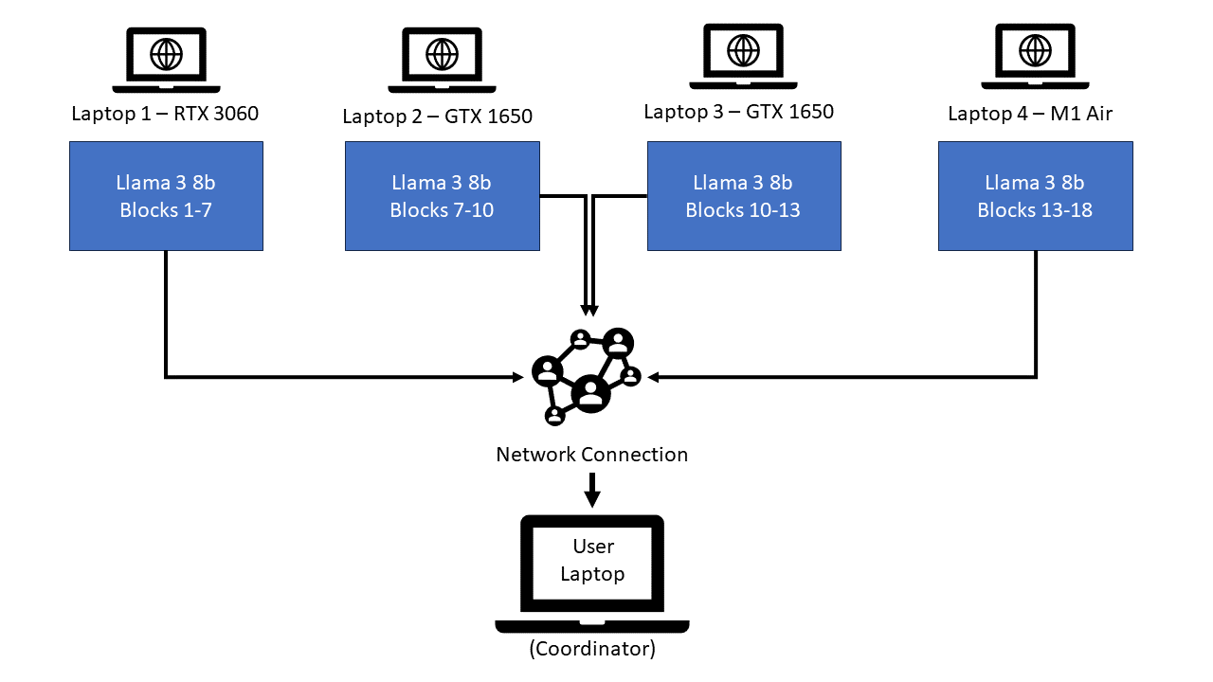
OUR SETUP
Notes:
These 4 laptops were connected together in a private swarm, forming our distributed PETALS network.
The large language model we aimed to host on this network was the recently released LLaMa 3-8B from Meta which is a new-state-of-art opensource Large Language Model which was released on april 18th.

Slide 12
BENCHMARKING
MMLU (Massive Multitask Language Understanding) is a new benchmark designed to measure knowledge acquired during pretraining by evaluating models exclusively in zero-shot and few-shot settings. This makes the benchmark more challenging and more similar to how we evaluate humans.
The test covers 57 tasks including elementary mathematics, US history, computer science, law, and more. To attain high accuracy on this test, models must possess extensive world knowledge and problem solving ability.
Notes:
As large language models continue advancing, we need robust benchmarks to evaluate their capabilities. We need to Test models' world knowledge and reasoning skills as well.
MMLU, or the Massive Multitask Language Understanding benchmark, aims to fill this gap.

Slide 13
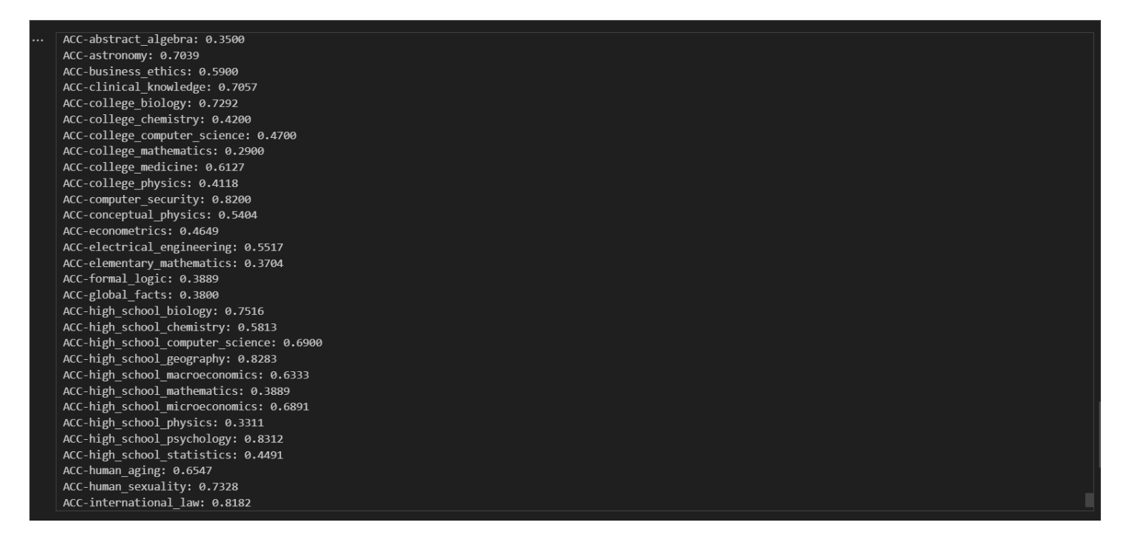
Notes:
It comprises a diverse set of 57 tasks spanning multiple domains like mathematics, history, science, law, and more. Crucially, MMLU evaluates models exclusively in zero-shot and few-shot settings, where they must rely solely on their preexisting knowledge without any task-specific training data.

Slide 14
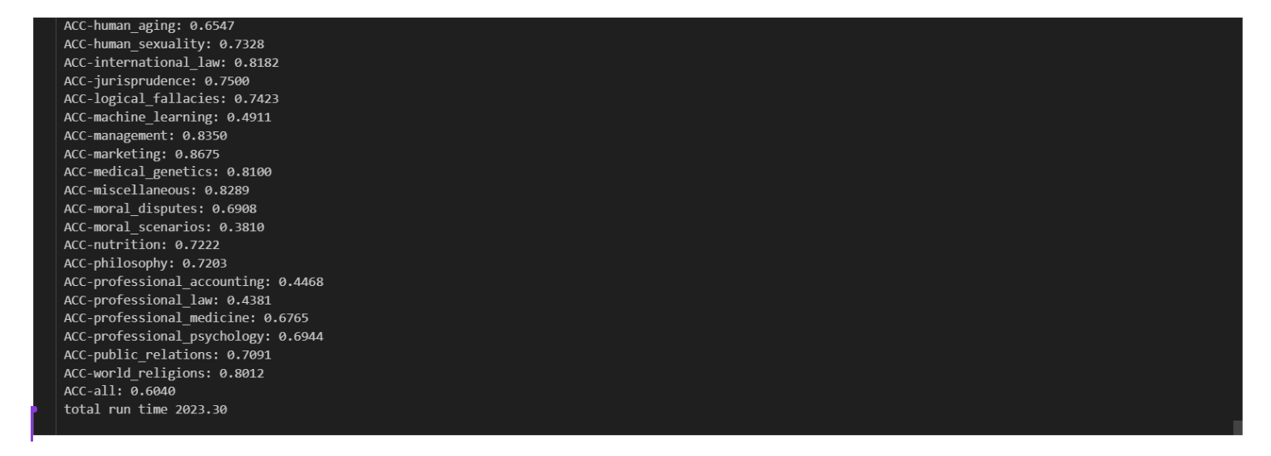
Notes:
This approach more closely mirrors how humans apply their learned knowledge to new situations, making MMLU a challenging yet meaningful measure of an LLM's world understanding and problem-solving prowes.

Slide 15
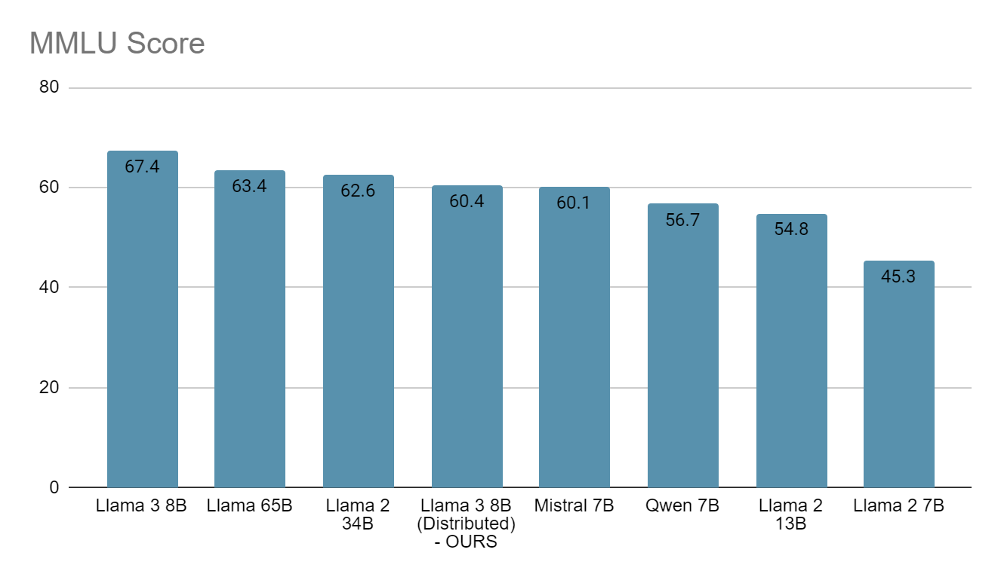
Notes:
The MMLU benchmark results provide valuable insights into the performance of state-of-the-art large language models across a wide range of challenging tasks. Among the centralized models evaluated by Meta, the Llama 3 8B model achieved the highest score of 67.4, closely followed by the Llama 65B at 63.4 and the Llama 2B 34B at 62.6.
Our distributed implementation of the Llama 3B 8B model, utilizing the Petals framework, attained a competitive score of 60.4 on the MMLU benchmark. While lower than the centralized Llama 3B 8B model's published result, our score outperformed several other state-of-the-art models, including Mistral 7B at 60.1, Qwen 7B at 56.7, and the Llama 2B family of models, with the 13B variant scoring 54.8 and the 7B variant scoring 45.3.

Slide 16
FUTURE RESEARCH DIRECTIONS
Optimize communication protocols and load balancing algorithms for distributed architectures.
Integrate heterogeneous hardware accelerators (FPGAs, ASICs) into distributed architectures.
Explore edge computing paradigms to minimize latency and bandwidth constraints in distributed systems.
Explore parallel inference architectures which can be done in centralized systems, as the current architecture doesn’t supports batch inferencing
Notes:
As we look towards the future of distributed architectures for large language models, there are several promising avenues for optimization and exploration. One key area is enhancing communication protocols and load balancing algorithms to minimize overhead and bottlenecks in the parallelized model execution across the distributed cluster. Advanced protocols and dynamic request routing mechanisms can significantly improve efficiency.
Additionally, integrating heterogeneous hardware accelerators like FPGAs and ASICs into the distributed infrastructure presents an opportunity to leverage specialized architectures optimized for efficient tensor operations. This hybrid approach, combining varying computational capabilities, could further boost performance.
Exploring edge computing paradigms is another intriguing direction, aiming to minimize latency and bandwidth constraints often faced in centralized cloud systems. By bringing LLM capabilities closer to data sources and end-users through edge deployments, we can enable a wider range of latency-sensitive applications.
Moreover, current implementations primarily focus on model parallelism for single inference requests. Investigating architectures that enable efficient batched inference can help leverage the full parallel computing power of hardware accelerators like GPUs and TPUs, enhancing throughput.

Slide 17
CONCLUSION
Architectural choices for LLMs have significant implications for performance, scalability, and resource utilization.
Distributed architectures offer a compelling alternative for cost-effective, energy-efficient, and accessible LLM deployment.
Findings contribute to the ongoing discourse and guide researchers and practitioners in making informed decisions.
Notes:
From the results of the study ,we can say that Architectural design decisions are critical in the context of Large Language Models (LLMs), as they have a significant influence on scalability, performance, and resource consumption. Distributed architectures stand out among these architectural factors as a strong substitute, providing LLM deployment options that are accessible, affordable, and energy-efficient.
The results of studies on distributed architectures make a substantial contribution to the current discussion about LLM development. Additionally, they provide practitioners and researchers with invaluable guidance, enabling them to make well-informed decisions that will influence the direction language model technology takes in the future. Through the utilization of distributed architectures, researchers facilitate the progress of language model deployment and utilization, guaranteeing a more promising and long-lasting future for LLM development.

Slide 18
ACKNOWLEDGEMENT
We would like to express our profound gratitude to Dr. Animesh Chaturvedi sir for all of his help and support during this project. Our research's direction and successful completion have been greatly aided by Dr. Chaturvedi sir’s guidance. We have been inspired and motivated at every turn by his unwavering dedication to academic excellence and the advancement of knowledge. We are sincerely appreciative of his mentoring and the chance to benefit from his extensive experience.
Notes:
So we would like to acknowledge the contribution of Dr. Animesh Chaturvedi Sir who guided us in designing and executing this project.

Slide 19
THANK YOU
OUR TEAM
Aarsh Desai - 21BDS001
N.V.J.K Kartik - 21BDS041
Priyesh Gupta - 21BDS050
Vinayak - 21BDS069
Vivaan Sharma - 21BDS070
Notes:
And these are the details of our team. Thank you for listening to this presentation

